Slide 1
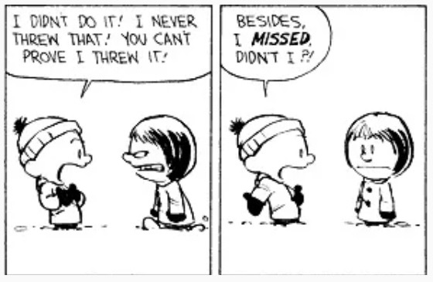

Slide 2
Module 10: Hypothesis Testing

Slide 3

My takeaway: Nothing is perfect, but failing to disprove something you want to prove is the closest thing to proving it!
Notes:
Duration: 4m43s

Slide 4
Hypothesis Testing Framework
Q1: Is there a decision/change that you want/need to make?
Q2: Is the decision unique (and you cannot find an answer online)?
Q3: Can the decision be made based on something that can be measured quantitatively?
Q4: Is the decision based on some form of repetition?
Q5: Are the data collected properly without biases?
Q6: How much deviations from the ideal/desired outcome can you tolerate?
Notes:
Additional notes:
Q1: In other words, is there an objective/goal?
Q2: Can you find the answers online?
Q3: “Quantitative” doesn’t mean it has to be a numerical variable. It could also be in categorical variables too because we can get numbers (like frequencies or percentages).
Q4: We need to have repeated measures to understand the “uncertainty”.
Q5: Is the sample drawn properly? Are any of the bias involved (selection, response, non-response, cognitive, survivorship, to name a few) in the process?
Q6: This is unique to hypothesis testing and it is related to the Significance Level (more later).

Slide 5
Parameter vs. Statistics (Revisit)
Parameter is defined as a number from the population and its value is unknown.
However, we really want to learn something about it.
Instead, we draw a decent sample (from the population) and get a statistic.
In short, a statistic (from the sample) is used to estimate the parameter (of interest).
Key condition in hypothesis testing: values of parameters are always unknown.

Slide 6
Examples (Parameters)
Example 1: Langara RES has recently hired new staff members and hope to reduce the students’ wait time at RES front counter. The wait time at the Langara RES front counter was 15 minutes before the hiring with a (popn.) standard deviation of 9 minutes. A senior registrar will write a report in 3 weeks.
Q: Find the parameter of interest.
Example 2: Tim Hortons has launched their new lunch items and expect more than 40% of their customers will buy their lunch items. The manager in the West Coast Region will collect the data and report to the director in 3 months.
Q: Find the parameter of interest.
Notes:
Example 1
Subjects = Langara students
Variable = the amount of wait time at the RES front counter
Type = numerical variable
Answer: Define mu as the average amount of wait time (in minutes) all students at the RES front counter, after the recent hiring
Example 2
Subjects = all customers at the Cafeteria
Variable = whether or not the customer will buy the new lunch items
Type = categorical variable
Answer: Define p as the proportion of all customers who buy the new lunch items

Slide 7
The Set up of H0 and Ha
Story: My roommate broke my favourite mug
Two key takeaways:
1) When the real cause is unknown to us, we can never prove things directly
2) To adopt this method, there can only have 2 opposing outcomes
Basic setup:
- the Alternative Hypothesis (or Ha) is the statement we want to prove
- the Null Hypothesis (or H0) is the statement we try to reject
But how?

Slide 8
Examples (Hypotheses)
Example 1: Langara RES has recently hired new staff members and hope to reduce the students’ wait time at RES front counter. The wait time at the Langara RES front counter was 15 minutes before the hiring with a (popn.) standard deviation of 9 minutes. A senior registrar will write a report in 3 weeks.
Set up the null hypothesis and the alternative hypothesis.
Example 2: Tim Hortons has launched their new lunch items and expect more than 40% of their customers will buy their lunch items. The manager in the West Coast Region will collect the data and report to the director in 3 months.
Set up the null hypothesis and the alternative hypothesis.
Notes:
Example 1
Answer: H0: mu >= 15 vs. Ha: mu < 15
Note: 15 is the hypothesized value with a symbol of mu_0
Example 2
Answer: H0: p <= 0.40 vs. Ha: p > 0.40
Note: 0.40 is the hypothesized value with a symbol of p_0

Slide 9
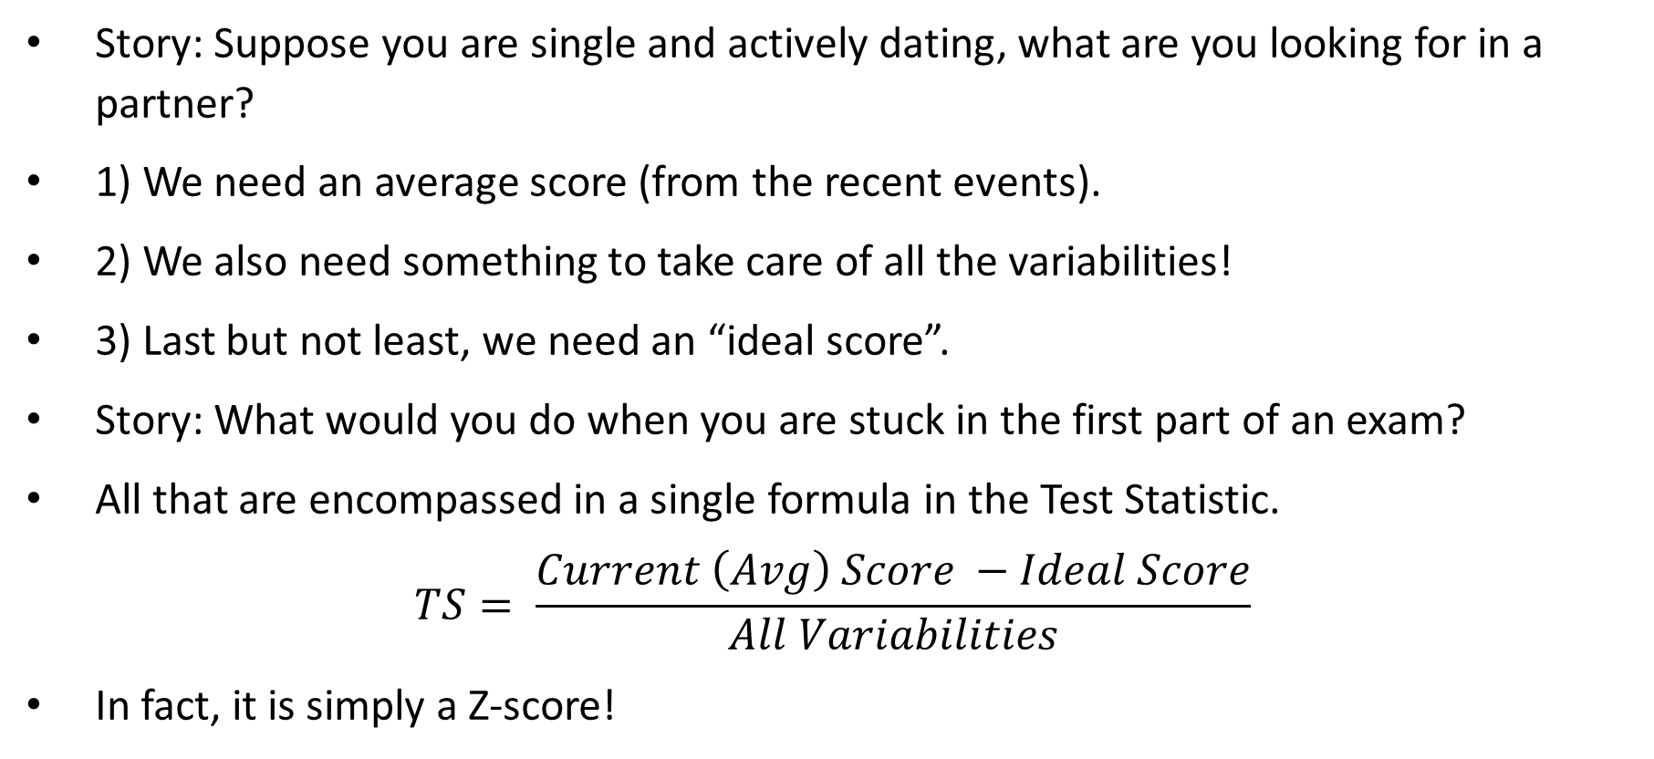
Test Statistics - Heuristics
Story: Suppose you are single and actively dating, what are you looking for in a partner?
1) We need an average score (from the recent events).
2) We also need something to take care of all the variabilities!
3) Last but not least, we need an “ideal score”.
Story: What would you do when you are stuck in the first part of an exam?
All that are encompassed in a single formula in the Test Statistic.
$$TS= \frac{Current \left(Avg\right) Score −Ideal Score}{All Variabilities}$$
In fact, it is simply a Z-score!

Slide 10
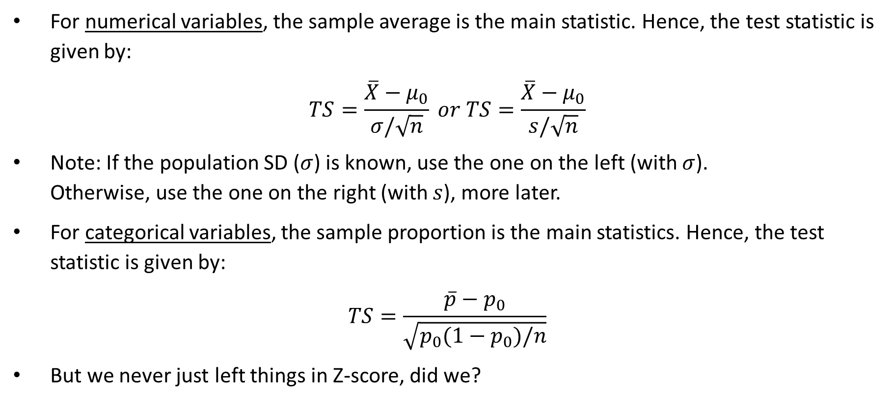
Test Statistics - Calculations
For numerical variables, the sample average is the main statistic. Hence, the test statistic is given by:
$$TS=\frac{\overline{X}−μ_{0}}{σ/\sqrt{n}} or TS=\frac{\overline{X}−μ_{0}}{s/\sqrt{n}}$$
Note: If the population SD ($σ$) is known, use the one on the left (with $σ$). Otherwise, use the one on the right (with $s$), more later.
For categorical variables, the sample proportion is the main statistics. Hence, the test statistic is given by:
$$TS=\frac{\overline{p}−p_{0}}{\sqrt{p_{0}(1−p_{0})/n}}$$
But we never just left things in Z-score, did we?

Slide 11
Examples (Test Statistics)
Example 1: Langara RES has recently hired new staff members and hope to reduce the students’ wait time at RES front counter. The wait time at the Langara RES front counter was 15 minutes before the hiring with a (popn.) standard deviation of 9 minutes. A senior registrar will write a report in 3 weeks. A random sample of 50 students waiting at the RES front counter was drawn. It was found that the average wait time was 13.5 minutes.
Q: Calculate the test statistic.
Example 2: Tim Hortons has launched their new lunch items and expect more than 40% of their customers will buy their lunch items. The manager in the West Coast Region will collect the data and report to the director in 3 months. A random sample of 100 customers was drawn. It was found that 50 of them bought the new lunch items.
Q: Calculate the test statistic.
Notes:
Example 1
sigma = 9
SD = 9/sqrt(50) = 1.2728
TS = (13.5 – 15)/1.2728 = -1.178 -> rounded to -1.18
Example 2
pbar = X/n = 50/100 = 0.5
SD = sqrt(0.4*0.6/100) = 0.049
TS = (0.5 – 0.4)/0.049 = +2.04

Slide 12
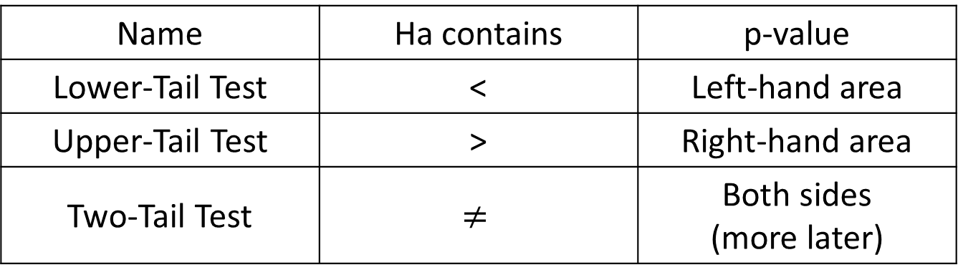
p-Values
In theory, the p-value is defined (loosely) as the probability that a more extreme event is going to happen, given the belief of H0.
In practice, it simply refers to the tailed area of the Z-distribution, depending on which direction the Ha is pointing at.
Name | Ha contains | p-value
Lower-Tail Test | < | Left-hand area
Upper-Tail Test | > | Right-hand area
Two-Tail Test | $$≠$$ | Both sides (more later)

Slide 13
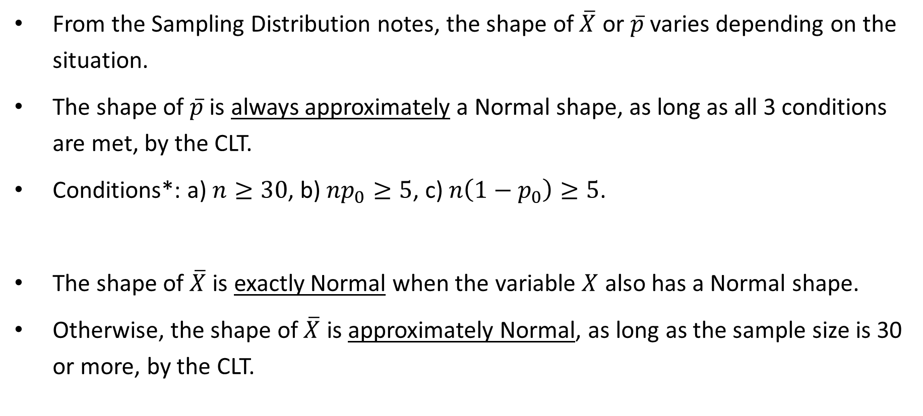
Exact or Approx. – Checking Conditions
From the Sampling Distribution notes, the shape of $\overline{X}$ or $\overline{p}$ varies depending on the situation.
The shape of $\overline{p}$ is always approximately a Normal shape, as long as all 3 conditions are met, by the CLT.
Conditions*: a) $n≥30$, b) $np_{0}≥5$, c) $n\left(1−p_{0}\right)≥5$.
The shape of $\overline{X}$ is exactly Normal when the variable $X$ also has a Normal shape.
Otherwise, the shape of $\overline{X}$ is approximately Normal, as long as the sample size is 30 or more, by the CLT.
Notes:
* Note that the conditions are slightly different than the one from Sampling Distributions notes.
Reasons: In any hypothesis testing procedure, the parameter p is unknown, but under H0, p will then take the value of the hypothesized value of p0.

Slide 14
Examples (p-values)
Example 1: Langara RES has recently hired new staff members and hope to reduce the students’ wait time at RES front counter. The wait time at the Langara RES front counter was 15 minutes before the hiring with a (popn.) standard deviation of 9 minutes. A senior registrar will write a report in 3 weeks. A random sample of 50 students waiting at the RES front counter was drawn. It was found that the average wait time was 13.5 minutes.
Example 2: Tim Hortons has launched their new lunch items and expect more than 40% of their customers will buy their lunch items. The manager in the West Coast Region will collect the data and report to the director in 3 months. A random sample of 100 customers was drawn. It was found that 50 of them bought the new lunch items.
Q: Find the p-value of both examples.
Q: Are the p-values exact or approximate? Is the approximation any good?
Notes:
Example 1
Previously, TS = -1.18
Since Ha contains “<“, we want the left-hand area.
-> p-value is 0.1190
The p-value is only an approximate value (because the variable of interest is not known to have a Normal shape).
Since n = 50, which is bigger than the requirement of 30, the approximation is good (enough), according to the CLT.
Using R:
z.test(Data1, alternative = "l", mu = 15, sigma.x = 9)
Example 2
Previously, TS = +2.04
Since Ha contains “>”, we want the right-hand area.
-> p-value is 1 – 0.9793 = 0.0207
The p-value is only an approximate value (because the shape of pbar is always approx.)
The approximation is good (enough) because all 3 conditions below are met, according to the CLT.
1) n = 100, which is bigger than the requirement of 30,
2) np0 = 100*0.4 = 40, which is bigger than the requirement of 5,
3) n(1-p0) = 100*(1-0.4) = 100*0.6 = 60, which is bigger than the requirement of 5.
Using R:
1) Use binom.test(x = 50, n = 100, alternative = “g”, p = 0.4) gives the exact probability using Binomial distribution.
2) Use prop.test(x = 50, n = 100, alternative = “g”, p = 0.4) gives a very good approx. to the true value. It uses a “continuity correction factor”.
3) Use pnorm() to find p-value once the TS is calculated. This is the closest to what we do manually.

Slide 15

Levels of Significance
Remember Q6 in the Framework, about the tolerance?
The one thing that can trump/beat all other outcomes comes from YOU!
And it is you who decide on the Significance Level (or 𝛼).
Smaller 𝛼 value means that you have set a high bar in rejecting the H0, like you have a high standard in picking your significant other.
Larger 𝛼 value means that you have set a low bar in rejecting the H0, like you have a lower standard.
There are 3 common significance levels in hypothesis testing.
Note: The significance level of 5% is always used when it is not given.
Significance Level | 1% | 5% | 10%

Slide 16
Conclusions
When p-value is less than 𝛼, H0 will be rejected.
When p-value is larger than or equal to 𝛼, H0 will not be rejected.
Two things to note:
1) Only H0 is to be rejected or not. It has nothing to do with Ha yet.
2) The two conclusions are opposite to each other. Have we seen that before?
Recall that Ha is the one we want to show.
Hence, the final part of the conclusion has to be about Ha.

Slide 17
Examples (Conclusions)
Example 1: Langara RES has recently hired new staff members and hope to reduce the students’ wait time at RES front counter. The wait time at the Langara RES front counter was 15 minutes before the hiring with a (popn.) standard deviation of 9 minutes. A senior registrar will write a report in 3 weeks. A random sample of 50 students waiting at the RES front counter was drawn. It was found that the average wait time was 13.5 minutes.
Q: Draw an appropriate conclusion with 5% significance level.
Example 2: Tim Hortons has launched their new lunch items and expect more than 40% of their customers will buy their lunch items. The manager in the West Coast Region will collect the data and report to the director in 3 months. A random sample of 100 customers was drawn. It was found that 50 of them bought the new lunch items.
Q: Draw an appropriate conclusion with 5% significance level.
Notes:
Example 1
Since the p-value (0.1190) is bigger than the 5% significance level, we do not have enough statistical evidence to reject H0
and conclude that the average amount of wait time (in minutes) of all students at the RES front counter, after the hiring, is not significantly smaller than 15 minutes.
Example 2
Since the p-value (0.0207) is smaller than the 5% significance level, we have enough statistical evidence to reject the null hypothesis
and conclude that the proportion of all customers who buy the new lunch items is significantly more than 45% (as anticipated).

Slide 18
Type I Error and Type II Error
Story: You are the prime suspect in a homicide case.
There are two types of errors: Type I error and Type II error.
Type I error = reject H0 when H0 is true.
Type II error = do not reject H0 when H0 is not true.
𝛼 = P(committing Type I error)
𝛽 = P(committing Type II error)
Which error is more serious? And which one will you minimize?
Notable examples: medical test in health, PED test in sports, spam mail recognition at work, post suggestion algorithm in social media
Notes:
Note: You have seen similar situation in Bayes’ Theorem.

Slide 19
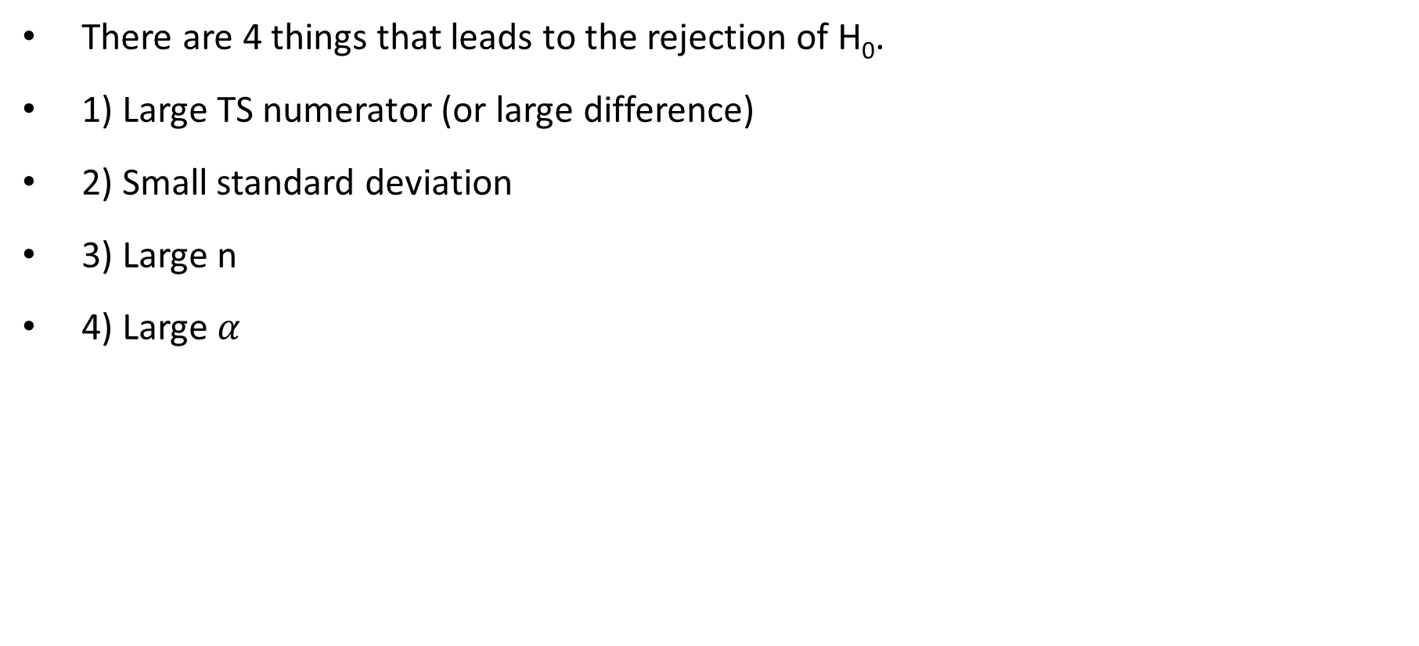
Putting it all Together
There are 4 things that leads to the rejection of H₀.
1) Large TS numerator (or large difference)
2) Small standard deviation
3) Large n
4) Large $α$
Large TS
→ Small p-value
Small TS denominator
Setting a low bar

Slide 20
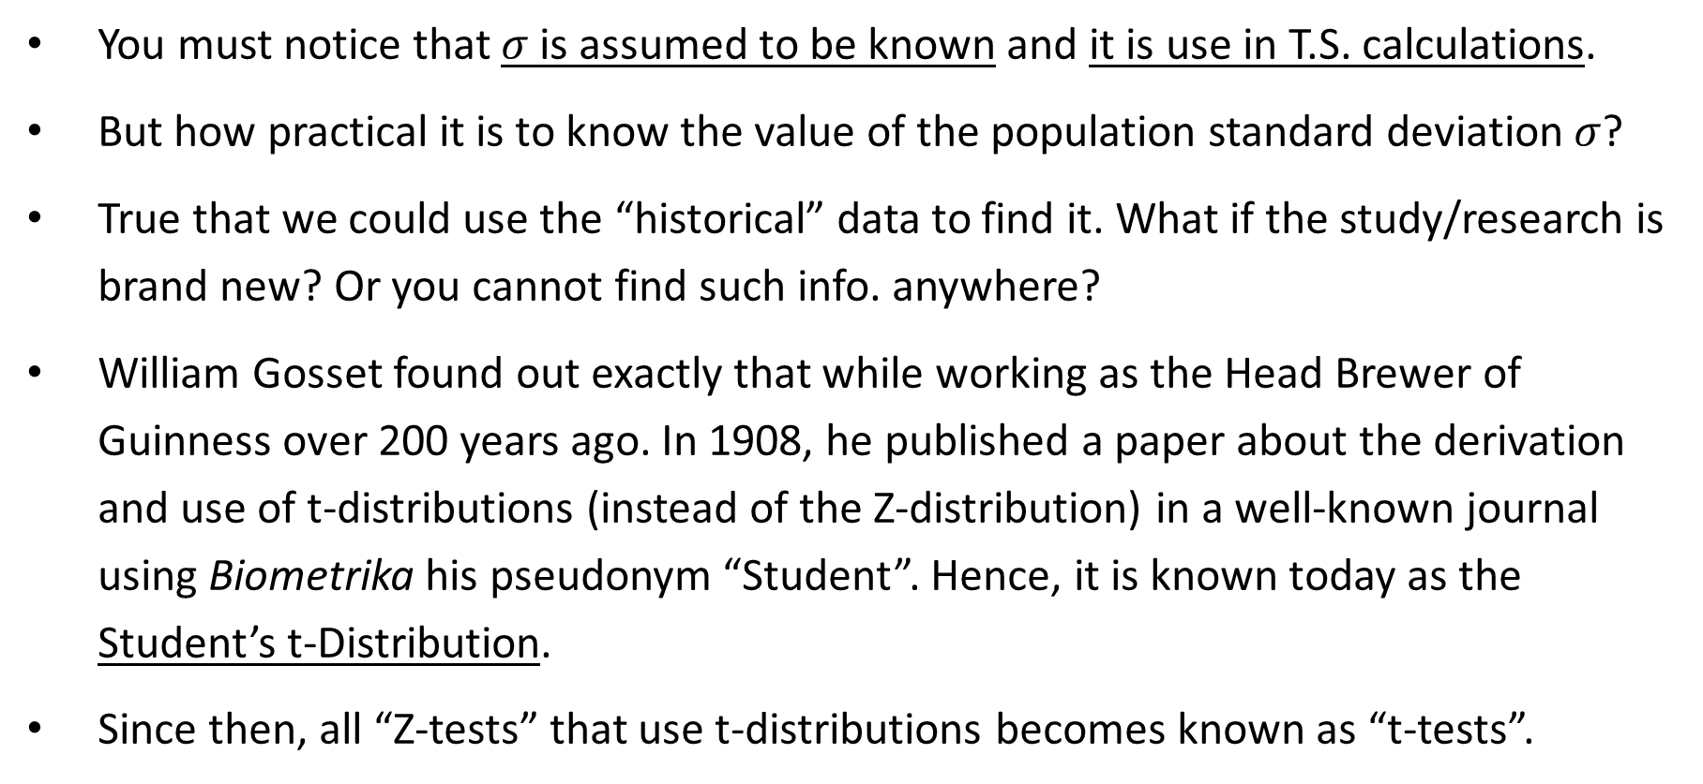
Z-Test vs. t-Test
You must notice that $σ$ is assumed to be known and it is use in T.S. calculations.
But how practical it is to know the value of the population standard deviation $σ$?
True that we could use the “historical” data to find it. What if the study/research is brand new? Or you cannot find such info. anywhere?
William Gosset found out exactly that while working as the Head Brewer of Guinness over 200 years ago. In 1908, he published a paper about the derivation and use of t-distributions (instead of the Z-distribution) in a well-known journal using Biometrika his pseudonym “Student”. Hence, it is known today as the Student’s t-Distribution.
Since then, all “Z-tests” that use t-distributions becomes known as “t-tests”.

Slide 21
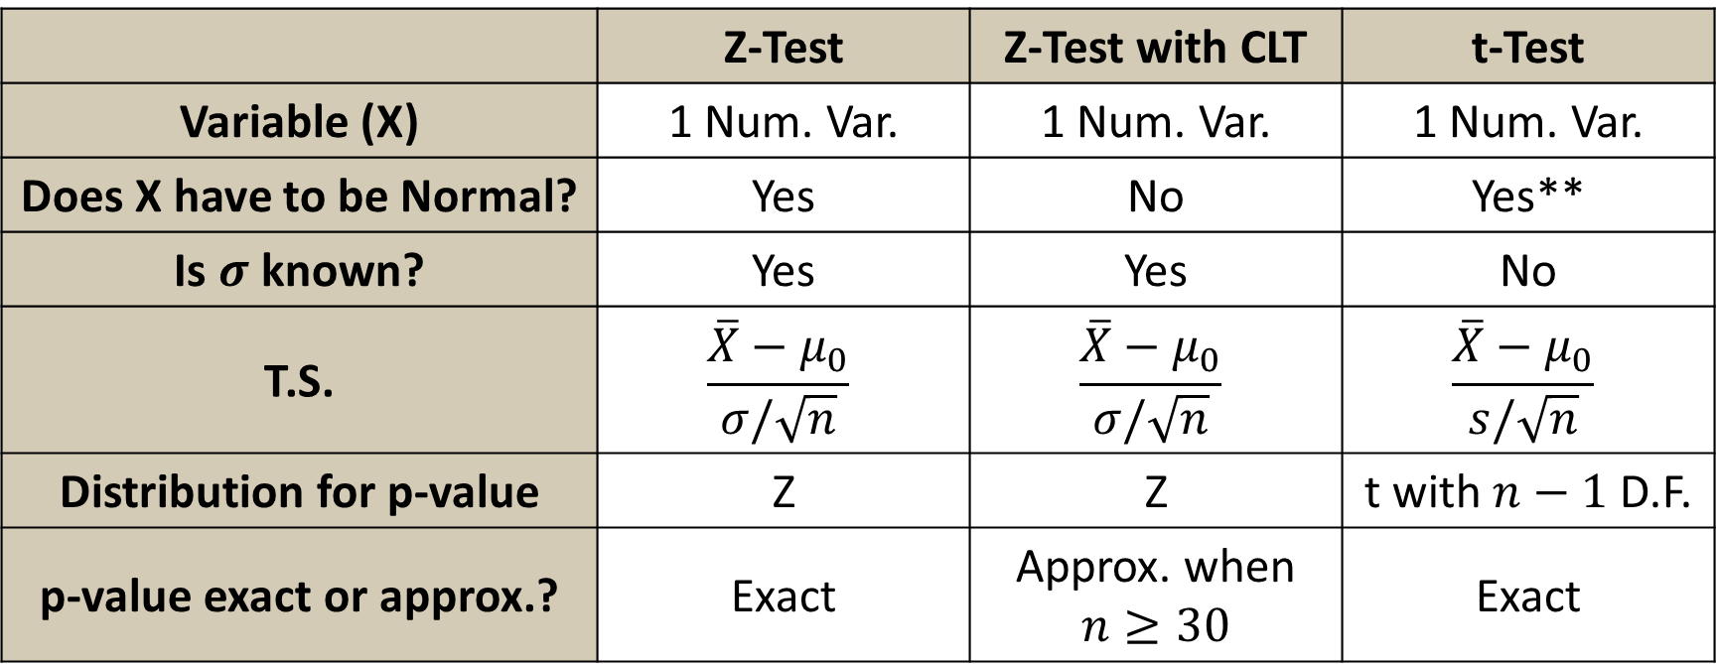
The Summary
Here is a summary of all 3 tests for a single numerical variable.
 | Z-Test | Z-Test with CLT | t-Test
Variable (X) | 1 Num. Var. | 1 Num. Var. | 1 Num. Var.
Does X have to be Normal? | Yes | No | Yes**
Is $σ$ known? | Yes | Yes | No
T.S. | $$\frac{\overline{X}−μ_{0}}{σ/\sqrt{n}}$$ | $$\frac{\overline{X}−μ_{0}}{σ/\sqrt{n}}$$ | $$\frac{\overline{X}−μ_{0}}{s/\sqrt{n}}$$
Distribution for p-value | Z | Z | t with $n−1$ D.F.
p-value exact or approx.? | Exact | Approx. when $n≥30$ | Exact
Notes:
** What if X is not Normal, yet sigma is unknown with small sample?
Good question. We could use “non-parametric tests”.
In data science field, they are practically not necessary.
But, just in case, there are two comparable ones (to t-tests):
1) Sign Test
2) Wilcoxon’s Signed Rank Test

Slide 22
Examples (Two-tailed Test using t-Dist.)
a) Home-use Christmas trees are typically grown in a tree farm where the diameter of Douglas Firs and hence its height are well monitored. Historically, the diameter of Douglas Firs for home use Christmas trees follows a Normal distribution with an average of 12 cm. Recent unpredictable weather has environmentalists concerned if the trees will grow unpredictably, i.e. diameter could be bigger or smaller. Define a parameter (with a symbol) and set up H0 and Ha.
b) A random sample of 16 Douglas Firs is drawn and the average diameter is 10.5 cm with a standard deviation of 2.5 cm. Calculate the test statistic, find p-value, check conditions, and draw conclusion with 1% level of significance.
Notes:
a)
Subjects = (Douglas Fir) trees
Variable = diameter (in cm)
Type = numerical variable
Define mu as the average diameter of all trees in this tree farm.
H0: mu = 12 vs. Ha: mu <> 12
Note: the symbols “<>” or “!=“ are common to represent “not equal to” in text. They are coming from coding.
b)
SE = 2.5/sqrt(16) = 0.625
TS = (10.5 – 12)/0.625 = -2.4
With n = 16, DF = 16 -1 = 15
In row 15 of the t-table, the absolute value of the TS value falls between 2.1314 (with 0.025 tail prob) and 2.6025 (with 0.01 tail prob).
Since this is a two-tailed test, p-value is two times of the above.
Hence, p-values is between 2*0.01 and 2*0.025, or between 0.02 and 0.05.
No conditions to check here, but… it would be nice to make sure you understand why t-distribution is used.
1) One numerical variable
2) X (diameter) has a Normal distribution
3) sigma is not known and sample size is under 30
Conclusion:
Since the p-value is bigger than the 1% level of significance, we do not have enough statistical evidence to reject the null hypothesis and
conclude that the average diameter of all trees in this tree farm is not significantly different from 12 cm.
Using R:
t.test(Data3, alternative = "t“, mu = 12)
t.test(Data3, mu = 12)

Slide 23

Any Questions?

